Slide 1

TOPIC:-
PARENTING FOR TEENAGRERS
Submitted:- Shashwat Singhal
Submitted To :- Unnati Chaurasia

Slide 2
WHY ARE TEENAGE YEARS DIFFERENT?
Imagine This...
A 5-year-old asks,
"Can you help me?"
A 15-year-old says,
"I can do it myself."
That's the biggest change.
Explanation
Teenagers seek independence.
Their brain is still developing.
They experience emotional and physical changes.
They want freedom but still need guidance.
Speaker Notes:
Teenagers don't stop needing parents—they simply need them in a different way. They want independence while still relying on emotional support.

Slide 3
WHAT CHANGES DURING TEENAGE?
Physical Changes
Growth spurts
Hormonal changes
Emotional Changes
Mood swings
Increased sensitivity
Social Changes
More influence from friends
Desire to fit in
Mental Changes
Developing decision-making skills
Speaker Notes:
During adolescence, teenagers experience major changes physically, emotionally, socially, and mentally. These changes explain many of their behaviours.

Slide 4
BIGGEST CHALLENGES PARENTS FACE
Parents Often Say...
"My child doesn't listen."
"They're always on their phone."
"They don't share anything."
Reality
Teenagers are trying to discover their identity.
Speaker Notes:
Many conflicts arise because parents and teenagers have different expectations. Understanding these differences helps reduce misunderstandings.

Slide 5
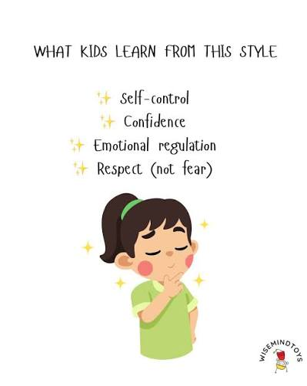
THE TRUST FORMULA
TRUST =Listening +Respect +Honesty +Consistency
Without trust,
Advice becomes criticism.
Trust is the foundation of a strong parent-teen relationship. When teenagers trust their parents, they are more likely to share their thoughts, problems, and feelings openly.
Speaker Notes:
Trust is built over time. When teenagers trust their parents, they're more likely to seek advice during difficult situations.

Slide 6

COMMUNICATION MATTERS
❌ Instead of saying:
"Because I said so."
✅ Say:
"Let's discuss why this rule is important."
Golden Rule
Listen twice as much as you speak.
Speaker Notes:
Effective communication means listening actively, respecting opinions, and explaining decisions rather than simply giving orders.

Slide 7
HOW PARENTS CAN COMMUNICATE EFFECTIVELY
Listen Actively 👂
Example:
Instead of checking your phone while they talk, maintain eye contact and listen carefully.
2. Speak with Respect 🗣️
Example:
Instead of saying, "You're always wrong," say, "Let's talk about another way to solve this."
3. Encourage Open Conversations 💬
Example:
Ask, "How was your day?" or "How are you feeling about school?“
4. Appreciate and Encourage 🌟
Example:
"I'm proud of the effort you put into your project.“
5. Solve Problems Together 🤝
Example:
If grades are low, ask, "What can we do together to improve?"

Slide 8
SOCIAL MEDIA – ENEMY OR FRIEND?
(Friend 😊)
1. Learning and Education
2.Communication
3.Creativity and Self – Expression
4.Career and Skill Development
5.Awareness
(Enemy ⚠️)
Screen Addiction
2. Cyberbullying
3. Privacy and Security Issues
4. Mental Health Problems
5. Fake News and Misinformation
Real-Life Example
Situation: A teenager spends 7–8 hours a day on social media, leading to poor grades and lack of sleep.
Wrong Approach: Taking away the phone without discussion.
Better Approach: Discuss the issue, agree on daily screen-time limits, encourage offline activities, and explain the importance of balance.

Slide 9
BUILDING SELF-CONFIDENCE
1. Appreciate Effort, Not Just Results 👏
Example:
"I'm proud of how much effort you put into preparing for your exam."
2. Encourage Independence 🌱
Example:
Let them plan their study schedule or manage a small budget.
3. Celebrate Small Achievements 🎉
Example:
Completing a project, improving marks, or learning a new skill.
4. Support Their Interests and Talents 🎨⚽
5. Teach That Mistakes Are Part of Learning 📚
Example:
A poor test score can become motivation to improve study habits.
Speaker Notes:
Confidence develops when teenagers feel supported and are allowed to learn from both successes and failures.

Slide 10
CONFLICT RESOLUTION
When arguments happen...
STOP
S – Stay Calm
Example:
Instead of yelling when your teenager breaks a rule, wait until both of you are calm before discussing it.
T – Think Before Speaking
Instead of:
"You never listen to me!"
Say:
"I'm concerned about what happened. Can we talk about it?"
O – Open Discussion
Example:
"Can you tell me what happened and how you felt?“
P – Problem Solving Together
Example:
If a teenager spends too much time on their phone, agree on a daily screen-time schedule together.
Speaker Notes:
Conflicts are normal. The goal is not to avoid them but to resolve them respectfully and constructively.

Slide 11
REAL- LIFE CASE STUDY
Situation
A 16-year-old spends 8 hours daily on social media.
Strict parents:
❌ Confiscate the phone.
Positive parents:
✔ Discuss the issue.
✔ Set screen-time limits together.
✔ Encourage offline activities.
Result
Better cooperation and responsibility.
Speaker Notes:
Involving teenagers in setting rules often leads to better outcomes than imposing rules without discussion.

Slide 12
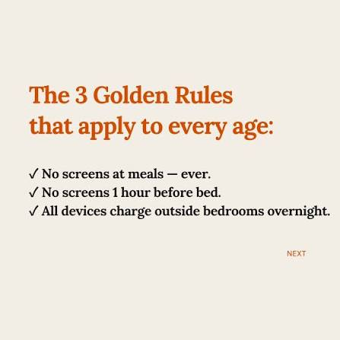
FIVE GOLDEN RULES
⭐ Listen First
⭐ Respect Feelings
⭐ Set Boundaries
⭐ Encourage Independence
⭐ Love Unconditionally
Speaker Notes:
These five principles form the foundation of positive parenting and help create a strong parent-teen relationship.

Slide 13

KEY TAKEAWAYS
Speaker Notes:
Positive parenting focuses on helping teenagers grow into responsible, confident, and caring adults.
Good Parenting is NOT
❌ Controlling
❌ Punishing
❌ Comparing
Good Parenting IS
✔ Guiding
✔ Supporting
✔ Trusting
✔ Inspiring

Slide 14
CONCLUSION
Parenting teenagers is about building trust, communicating openly, and guiding with love and patience. By encouraging independence, setting healthy boundaries, and supporting their emotional well-being, parents help teenagers grow into confident, responsible, and successful adults.
Final Thought
"The goal of parenting is not to control teenagers, but to prepare them to become confident, responsible, and compassionate adults."

